Slide 1
IIT Bombay
Page 1
Course Code : EE 611
Department: Electrical Engineering
Instructor Name: Jayanta Mukherjee
Email: jayanta@ee.iitb.ac.in
Lecture 17
EE 611 Lecture 17 Jayanta Mukherjee

Slide 2
IIT Bombay
Page 2
Topics Covered
Stepped Impedance FIlter
Commensurate Filter Design
Filter Prototypes
Scaling of prototypes
EE 611 Lecture 17 Jayanta Mukherjee

Slide 3
IIT Bombay
Page 3
Stepped impedance filter
Lumped elements are difficult to realize at high frequencies.
For narrowband cases, lumped element models of the
distributed network were good enough to get good
performance predictions
A short piece of high impedance line can model a series
inductance, while a short piece of low impedance line can
model capacitance (Prove it !!).
We can thus cascade low and high impedance line sections to
create an equivalent to our lumped element filter.
However the response will only match at the design frequency
Off the design frequency the stepped-impedance filter
response may not match the lumped network very well.
EE 611 Lecture 17 Jayanta Mukherjee

Slide 4
IIT Bombay
Page 4
Stepped impedance filter
Example of microstrip realization of low pass stepped impedance
filter
EE 611 Lecture 10 Jayanta Mukherjee
EE 611 Lecture 16 Jayanta Mukherjee
EE 611 Lecture 17 Jayanta Mukherjee

Slide 5
IIT Bombay
Page 5
Commensurate filter design
EE 611 Lecture 17 Jayanta Mukherjee

Slide 6
IIT Bombay
Page 6
Commensurate filter design
EE 611 Lecture 17 Jayanta Mukherjee

Slide 7
IIT Bombay
Page 7
Commensurate filter design
EE 611 Lecture 17 Jayanta Mukherjee

Slide 8
IIT Bombay
Page 8
Commensurate filter response
EE 611 Lecture 17 Jayanta Mukherjee

Slide 9
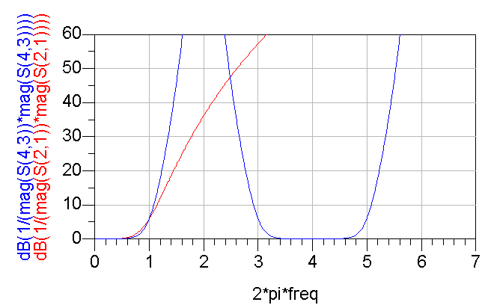
IIT Bombay
Page 9
Comparison of lumped and distributed
Filter Response
ω_{c}
ω_{r}
EE 611 Lecture 17 Jayanta Mukherjee

Slide 10
IIT Bombay
Page 10
Commensurate filter design
EE 611 Lecture 17 Jayanta Mukherjee

Slide 11
IIT Bombay
Page 11
Frequency and impedance scaling
Low pass
prototype
EE 611 Lecture 17 Jayanta Mukherjee

Slide 12
IIT Bombay
Page 12
Realizability issue
EE 611 Lecture 17 Jayanta Mukherjee

Slide 13
IIT Bombay
Page 13
Kuroda’s Identities
EE 611 Lecture 17 Jayanta Mukherjee

Slide 14
IIT Bombay
Page 14
Proof
EE 611 Lecture 17 Jayanta Mukherjee

Slide 15
IIT Bombay
Page 15
Using the Kuroda identities
To use the Kuroda identities we usually need to add Z₀ unit
elements before or after the filter.
The identities can be used to get rid of the series stubs
In the 3rd order example above we have Z₁=Z₃=nZ₀, C₁=C₃
=(n-1)/nZ₀, and n=1+L/Z assuming L₁=L₃=L.
EE 611 Lecture 17 Jayanta Mukherjee

Slide 16
IIT Bombay
Page 16
A simple normalized example
EE 611 Lecture 17 Jayanta Mukherjee

Slide 17
IIT Bombay
Page 17
Example
EE 611 Lecture 17 Jayanta Mukherjee

Slide 18
IIT Bombay
Page 18
Horton & Wenzel Filters
Optimum Multipole Quarter-Wave TEM Filters IEEE MTT Symposium Digest, 1965 Publication Date: May 1965 Volume: 65, Issue: 1
EE 611 Lecture 17 Jayanta Mukherjee

